Slide 1


DESIGN OF RESUME MATCHING SYSTEM USING NLP
Dept. of Computer Application
Kalyani Government Engineering College
Maulana Abul Kalam Azad University of Technology
Presented by: Sudip Patra [10271023038]
Under the guidance of
Dr. Indrajit Bhattacharya
Assistant Professor, Dept. of CA, KGEC

Slide 2

Content
Introduction
Background & Problem Statement
Project Goals & Objectives
Technology Stack
Workflow
User Experience & Interface
Performance Measures
Conclusion
Future Enhancements
References

Slide 3
Introduction
Project Overview
Purpose
Target Audience
An AI-powered resume screening tool designed to automate and optimize candidate shortlisting.
Reduce manual effort, improve efficiency, and ensure unbiased hiring decisions.
HR teams, recruiters, hiring managers in organizations and College Training and placement cell

Slide 4
Background and Problem Statement
1
Manual Inefficiency
2
Human Bias
Handling a large number of resumes manually is inefficient and time-consuming.
Human bias can affect fair
candidate selection.
3
Matching Challenges
4
Inconsistency
Difficulty in matching resumes with job descriptions accurately.
Inconsistent hiring decisions
can occur.

Slide 5
Project Goals & Objectives
Automation
Accuracy
Bias Reduction
Automate resume screening to save recruiters' time and effort.
Improve accuracy in candidate-job matching, ensuring the right people for the right roles.
Reduce bias in hiring decisions by leveraging objective AI-driven analysis.
Ranking
Scalability & Performance
Data Security & Compliance
Provide ranked resumes based on job requirements, enabling efficient shortlisting.
Ensure the system can handle large volumes of resumes and maintain high performance.
Maintain robust data security measures and ensure compliance with relevant regulations.

Slide 6









Technology Stack
MySQL
KNN
HTML, CSS
Efficiently stores resume and job description data.
Machine learning algorithm for candidate ranking.
Create the user interface.
NLP
Cosine Similarity
TF-IDF
Natural Language Processing
for text analysis.
Measures semantic
similarity between text.
Text analysis technique for identifying important words.
Python Flask
Scikit-learn
NLTK
Web framework for
the application.
Machine learning library
for various algorithms.
Natural Language Toolkit
for text processing.

Slide 7
Workflow
Upload Resumes
1
Recruiters upload resumes in various formats (PDF, DOCX).
2
Information Extraction
The tool parses resumes to extract key information such as skills, experience, and education.
Matching
3
The extracted information is matched against the job description.
4
Ranking
Resumes are ranked based on their relevance to the job requirements.
Display
5
The best-matched resumes are displayed to the recruiter for review.

Slide 8
Not Register
Register
Start
Log in
Upload Resume
Student Section

Slide 9
Log in
Get all the resumes
Resume has errors
Rejected
Check the resumes
Resume is Okay
Approved
Match Resume With Job Description
Result
Admin Section

Slide 10




User Experience & Interface
Simple & Intuitive
The user interface is designed for simplicity and ease of use.
Upload
Recruiters can easily upload resumes and job descriptions.
View & Rank
View ranked resumes with match scores to efficiently identify top candidates.
Export
Export shortlisted resumes for further review and processing.

Slide 11
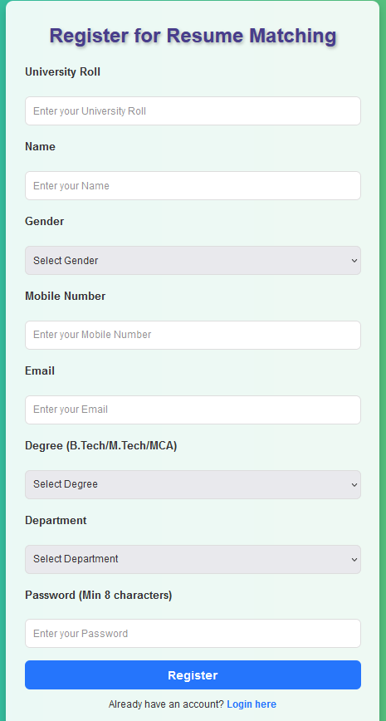
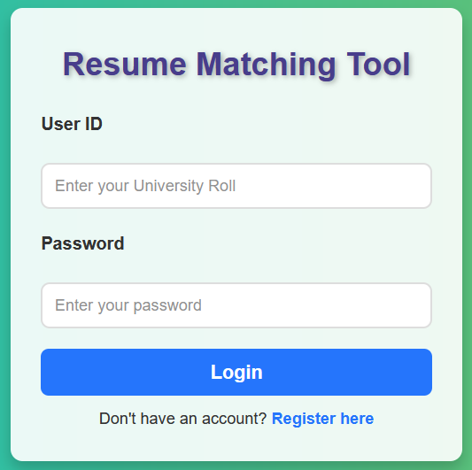

Slide 12
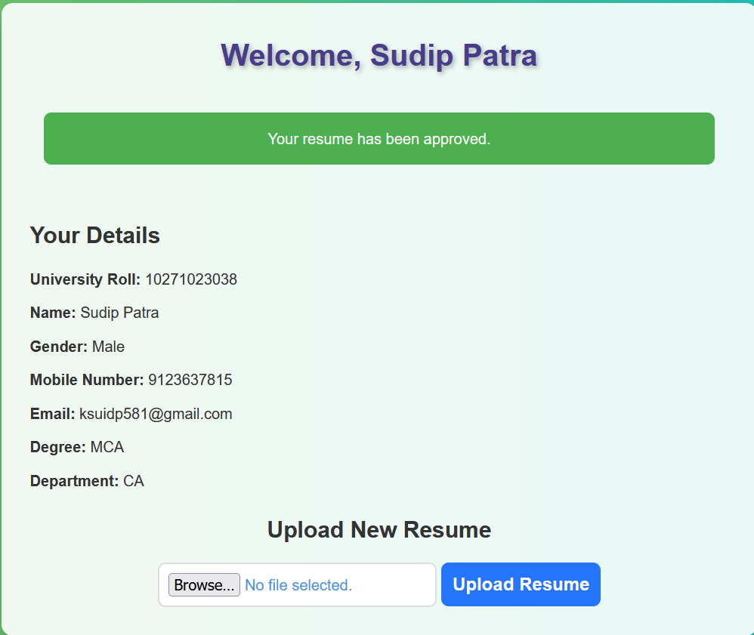

Slide 13
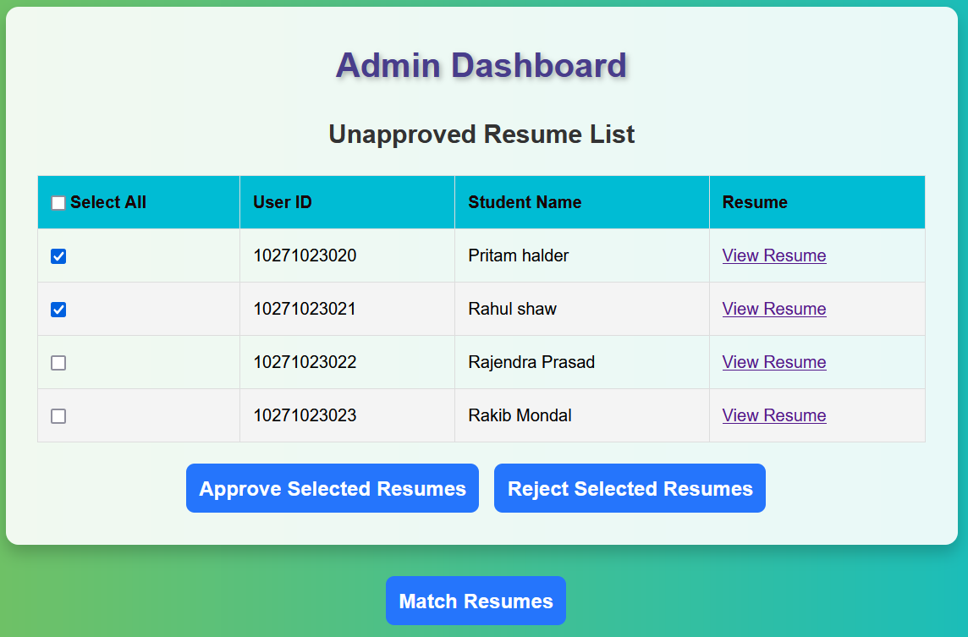

Slide 14
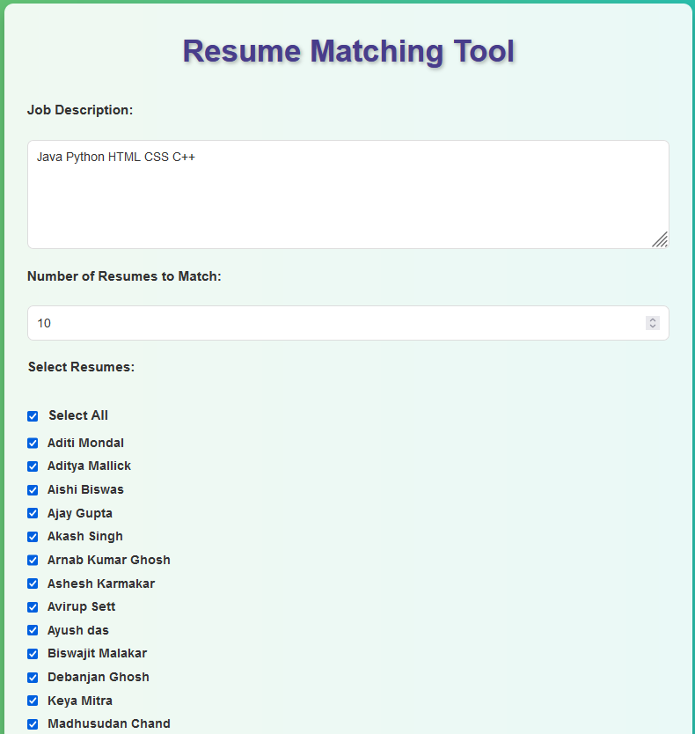
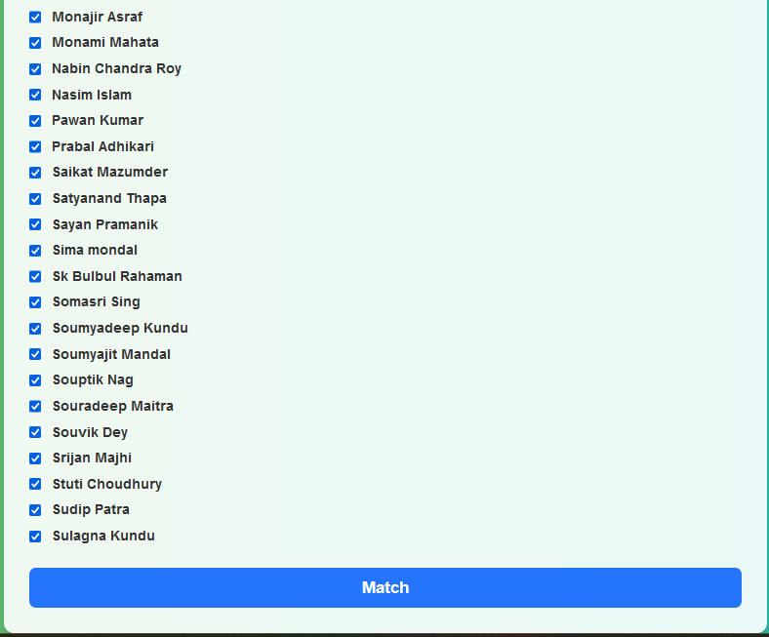

Slide 15
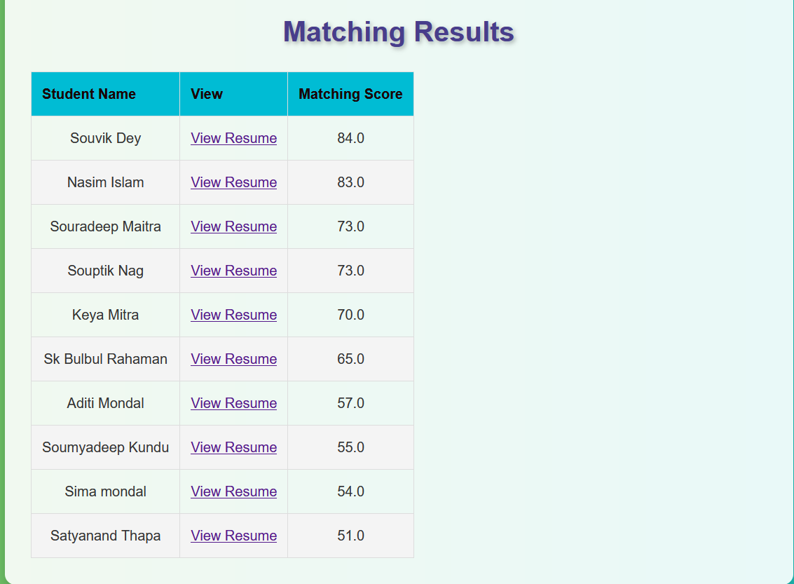

Slide 16
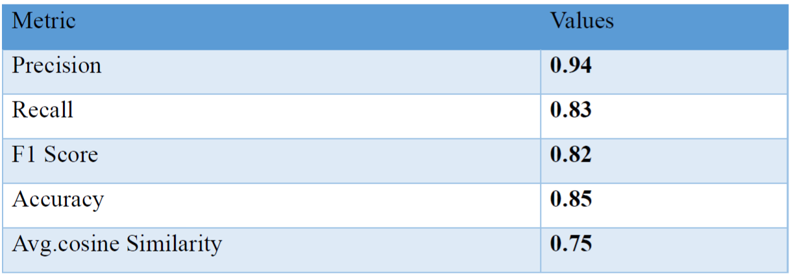
Performance Measures

Slide 17

Conclusion
Efficiency
The AI-powered resume screening tool significantly enhances efficiency.
Improved Hiring
It leads to improved hiring decisions by automating and optimizing the process.
Scalability
Provides a scalable solution for companies handling a large number of applications.

Slide 18

Future Enhancements
1
2
AI-Based Interviews
Multilingual Support
Implement AI-based interview suggestions to enhance the process further.
Support multilingual resumes to expand the tool's reach.
3
4
Model Enhancement
ATS Integration
Improve model accuracy by training on larger and more diverse datasets.
Integrate with Applicant Tracking Systems for seamless workflow integration.

Slide 19
References
• Salton, G., & McGill, M. J. (1983). Introduction to Modern Information Retrieval. McGraw-Hill.
• Ramos, J. (2003). Using TF-IDF to Determine Word Relevance in Document Queries. Proceedings of the First International Conference on Machine Learning.
• Singhal, A. (2001). Modern Information Retrieval: A Brief Overview. IEEE Data Engineering Bulletin.
• Mikolov, T., Chen, K., Corrado, G., & Dean, J. (2013). Efficient Estimation of Word Representations in Vector Space. arXiv preprint arXiv:1301.3781.
• Pennington, J., Socher, R., & Manning, C. D. (2014). GloVe: Global Vectors for Word Representation. Proceedings of the 2014 Conference on Empirical Methods in Natural Language Processing (EMNLP).

Slide 20
Thank You

